Slide 1
Hit Level Data Analysis

Slide 2
What is hit level data?
A hit level record is a single "hit" from a visitor on the client's site.
A visitor could navigate from one page to another with lot of different actions, hence it can be thought that this dataset is a journey of the visitor on clients website.

Slide 3
Business Problem Statement
How much revenue is the client getting from external Search Engines, such as Google, Yahoo and MSN, and which keywords are performing the best based on revenue?

Slide 4
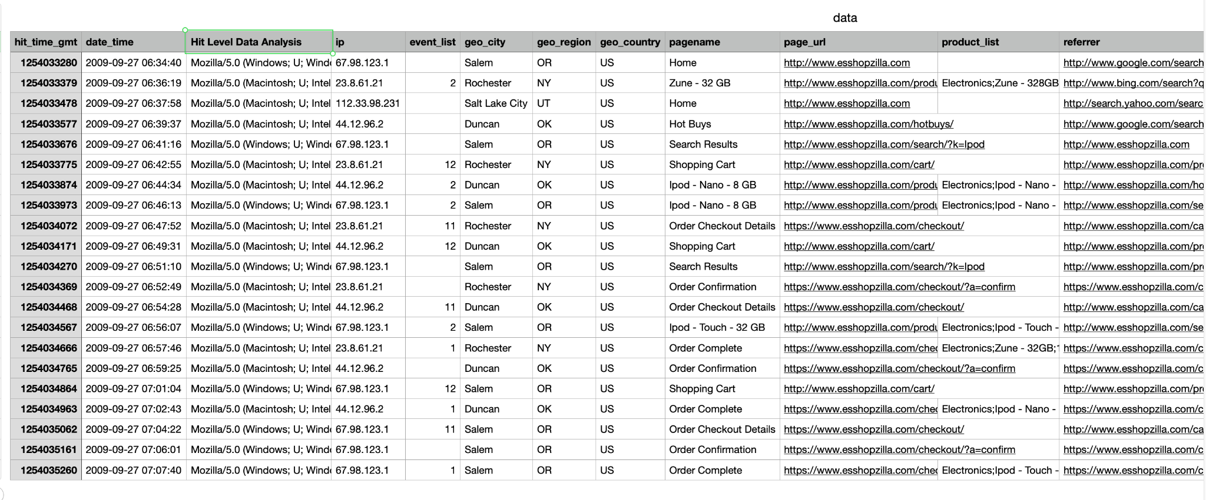
Data.tsv

Slide 5
Data exploration takeaways
The grain can be identified as the destination (pages) the visitor visits in journey of buying/ browsing a product.
Many different actions of the user are captured in the dataset with a timeline.
Product level details are captured for the visitor only when the action type is Purchase.
It also has location and user agent (device) information of the visitor.

Slide 6
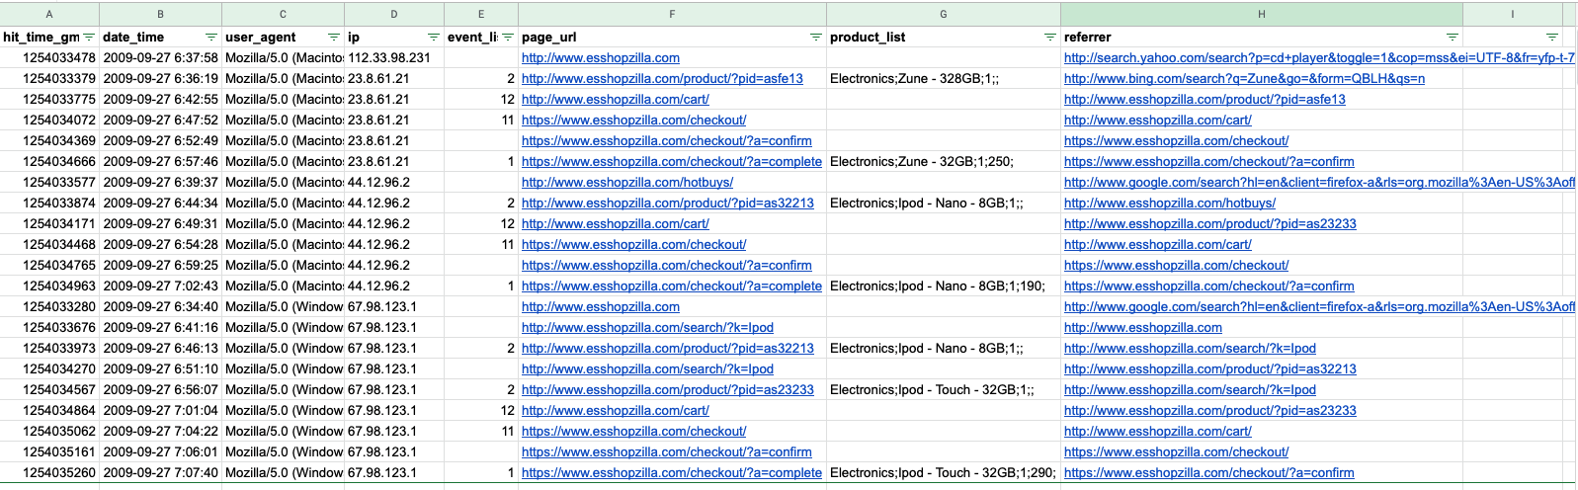
Sort by IP & Datetime
Referrer -> Page_url
Revenue found in rows where event_type = 1

Slide 7
Main challenge
Matching the start of a journey to the end of a journey for each visitor, mostly we are interested in the visitor who provided our client some revenue

Slide 8
Assumptions
Ip identifies a single user.
If the same user buys multiple products, even though different category, initial search keyword and search engine domain will be allocated that revenue, as there was no new search.
If there is a new search keyword or use of different search engine domain before end of purchase of the first item, then latest search keyword and search engine will be allocated that revenue, as there is no way to tell if the first search or second search resulted in buy of the first item.
'p=search' or 'q=search' are the only ways Google, MSN and Bing add search query to their URL, if there are other ways we might have to include that and also we will have to include other patterns for other search engines.

Slide 9
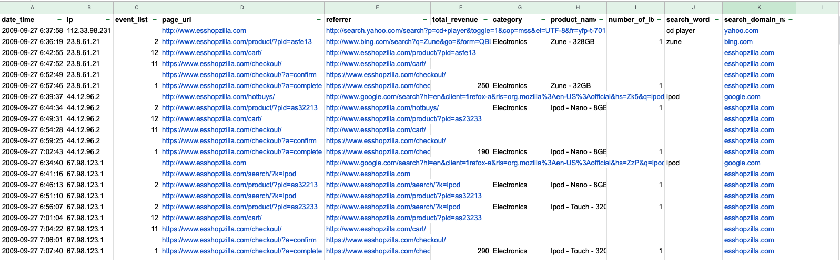
Unpacking columns and approach

Slide 10
Other Approaches?
Using sql like analytical function like lead/lag, first value/last value.
Filter on event_type =1 and then join back to original dataset
Sort only by time, instead of time and ip

Slide 11
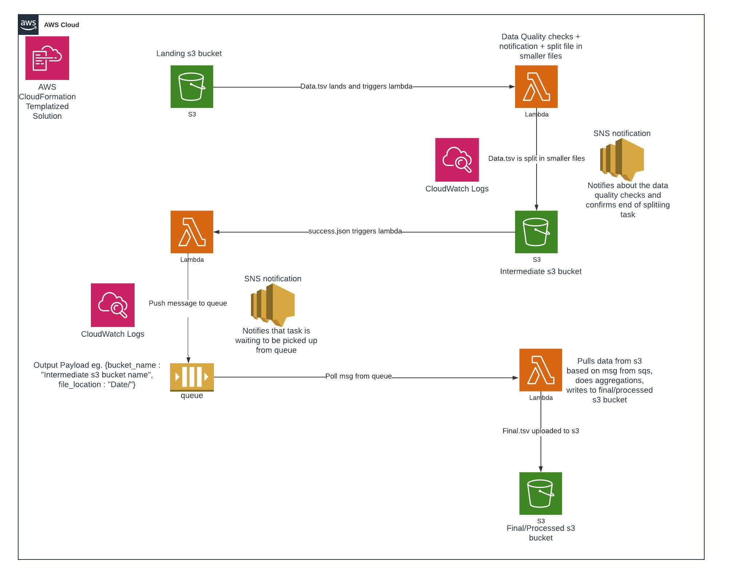
AWS Cloud Data pipeline Design

Slide 12
Recommendations?
Above solution represents the python functional programming way of solving the solution, the solution will be simpler in a database. Also, with MPP systems, it should be way quicker than in-memory calculations if we are thinking about scale. AWS EMR, Redshift are better products to implement this use case. We can utilize distribution and sort keys to optimize the processing.
If this processing has to be non-database solution, AWS EC2 will work better with scalability, Lambda with its 15 mins max timeout and restricted memory can be a bottleneck.
There are gaps with this solution with regards to CI/CD, which need to worked upon to have it built out on as a production level application.
With respect to business case, one recommendation that can be provided is to look for other metrics like count from search engine domains, percentage of dropouts on internal pages, etc which can further help drive discussions around improvement of user experience for the visitors.

Slide 13
Thank you!

